Slide 1
Southern California Economic Update

Slide 2
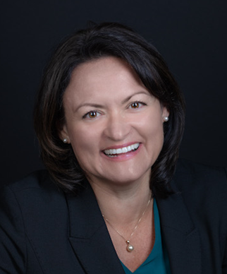
Gigi Moreno
Senior Economist
Southern California Association of Governments

Slide 3
SCAG EcONOMIC Roundtable
Imperial County
Michael Bracken
Development Management Group, Inc. (DMG)
Los Angeles County
Shannon Sedgwick
Los Angeles County Economic Development Corporation (LAEDC)
Orange County
Wallace Walrod
Tech Coast Consulting Group (TCCG) and Orange County Business Council (OCBC)
Riverside & San Bernardino Counties
Manfred Keil , Robert Kleinhenz & Fernando Lozano
Inland Empire Economic Partnership (IEEP)
Ventura County & SCAG Region
Mark Schniepp
California Economic Forecast (CEF)
Equity
Karthick Ramakrishnan
University of California, Riverside (UCR) and California 100
Sustainability
David Roland-Holst
Berkeley Economic Advising & Research (BEAR) and University of California, Berkeley
Workforce
Shaun Fernando
Guidehouse

Slide 4
UNEMPLOYMENT AT-A-GLANCE
Monthly Unemployment Rate October 2022
SCAG Region | 4.1%
Imperial | 16.2%
Los Angeles | 4.5%
Orange | 2.8%
Riverside | 4.0%
San Bernardino | 3.9%
Ventura | 3.3%
Rest of California | 3.5%
U.S. | 3.7%

Slide 5
SCAG IS BACK TO WORK

Slide 6
INFLATION EATING AWAY AT WAGES

Slide 7
SCAG REGION PRODUCTIVITY AT HISTORICAL HIGH

Slide 8
SCAG
COUNTY HIGHLIGHTS

Slide 9
IMPERIAL COUNTY

Slide 10
LOS ANGELES COUNTY

Slide 11
ORANGE COUNTY

Slide 12
RIVERSIDE & SAN BERNARDINO COUNTIES
Labor Force in Riverside and San Bernardino Counties, 2001 - 2022

Slide 13
RIVERSIDE & SAN BERNARDINO COUNTIES

Slide 14
VENTURA COUNTY
Per Capita Gross Domestic Product (GDP) in Ventura County, 2001-2022

Slide 15
Regional Outlook
Strong regional labor markets and infrastructure investments suggest SCAG region is well positioned for a softer landing from the likely national and global recession
Notes:
Risks to the region
Just talked about the strengths to the region that can shield the region.

Slide 16
Creating and sustaining growth
Attract investment to region by improving perceptions of local business climate
Implement a Business Climate Indicator to arouse and sustain investor interest in the region
Framework for such an index is proposed in Regional Briefing Book

Slide 17
More Insights
More insights and details in the Regional Briefing Book
scag.ca.gov/economicsummit
Notes:
Risks to the region
Just talked about the strengths to the region that can shield the region.

Slide 18
Let’s Continue the Conversation
SoCal Economic Trends Tool
scag.ca.gov/econtrends
Quarterly Update
scag.ca.gov/subscribe-updates
Social Media

Slide 19
Thank You!

